Slide 1

BBQReserver
Team5 - Final Presentation
@InnoBBQbot

Slide 2
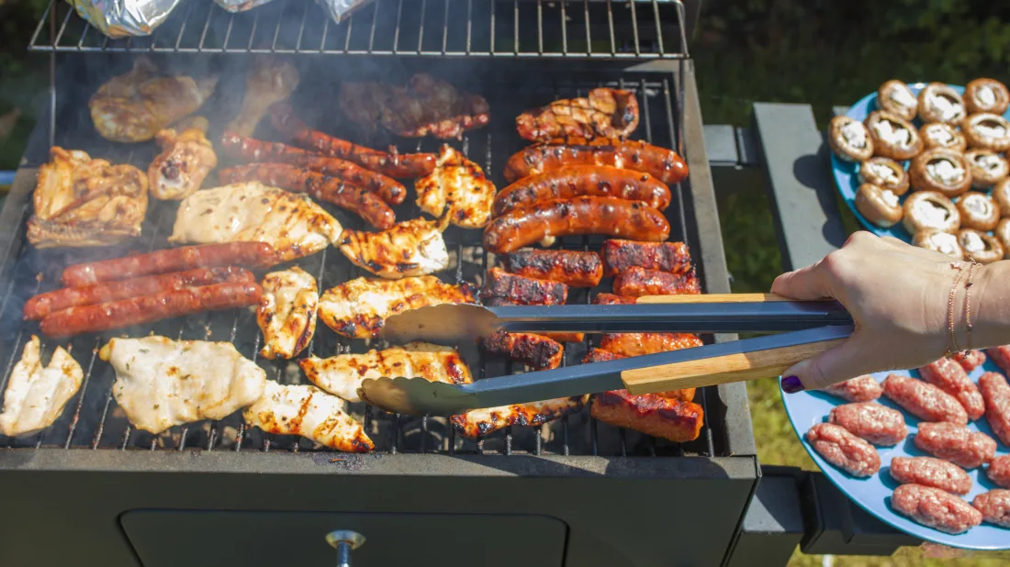
Project introduction, business goals
Notes:
We have beautiful bbqzone at innopolis. And BBQReserver is tool for automatic bbq zone reservation. You can book your zone by using telegram. Just by some several fingertips and you reserved a place for perfect weekend.

Slide 3
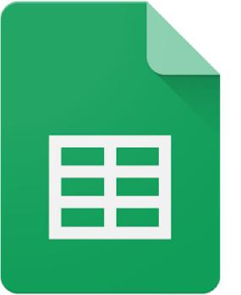


Project introduction, business goals
7 steps
5 mins
4 steps
1 min
Notes:
So why this project? Project proposal arose from the initial problems with reserving. Sadly, before if you want to book a barbeque zone for some period of time you need to make a record in an ​online table - on google sheets. ​You should check that nobody has already reserved your time slot and provide information about the number of people, the equipment you need and share your contacts.

Slide 4
Project introduction, business goals
Easy and handy experience
Automatic suggestion of free slots
Confirmation and cancellation
Notification about your bookings

Slide 5
Quality of the interview transcript
Traceability
P
Low connections between transcription and audio record
Completeness
P
Interview transcripts covered not all moments from audio record
Correctness
P-
Not all stakeholders were properly identified and justified

Slide 6
Quality of the use cases
Traceability
P-
There is no connection between codebase and use cases (link in github)
Completeness
P+
All features covered by uses cases. Almost all use cases have specific sections like assumption.
Correctness
P
Almost all uses cases are complete with use case template

Slide 7
Quality of the user interfaces
Traceability
P
Connection with use cases was not always clear
Completeness
P
Some alternative flows are not demonstrated
Correctness
P+
All use cases are covered by user interface mock-ups

Slide 8
Quality of the MVP
Traceability
P
Lack of comments and links to use cases.
Completeness
P-
Very bad codebase, not ready for further (release) development.
Correctness
P
Inconsistency in on use case. Some bugs were fixed.
Notes:
There are some inconsistencies in use case to choose reservation date, It wss specifed that the
bot returns date for just today, tomorrow and the day after tomorrow in the use case but in the
MVP, the functionality for choosing date provided to choose the month first, then the 31 days
within the month (despite of the total days of chosen month, e.g. you can choose November 31

Slide 9
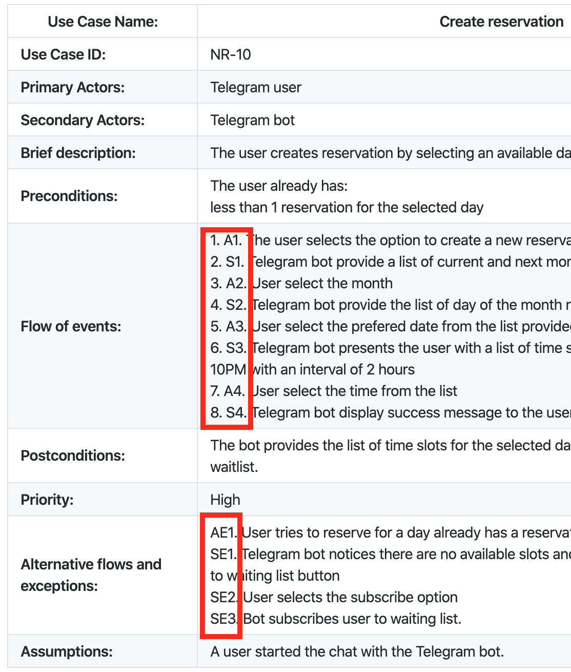
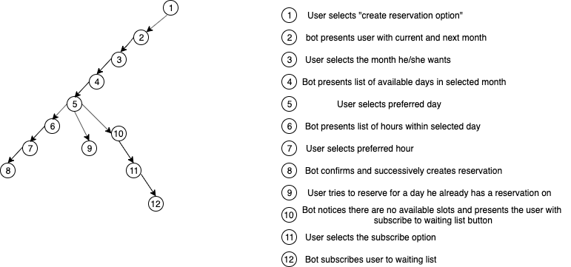
Quality management – decision point
Scenario 1 1 - 2 - 3 - 4 - 5 - 10 - 11 - 12 Scenario 2 1 - 2 - 3 - 4 - 5 - 9
Scenario 3
1 - 2 - 3 - 4 - 5 - 6 - 7 - 8
Notes:
For the quality assurance we identified decision points in the use cases, and on this base we created a decision trees, which gave us scenarios for test cases

Slide 10
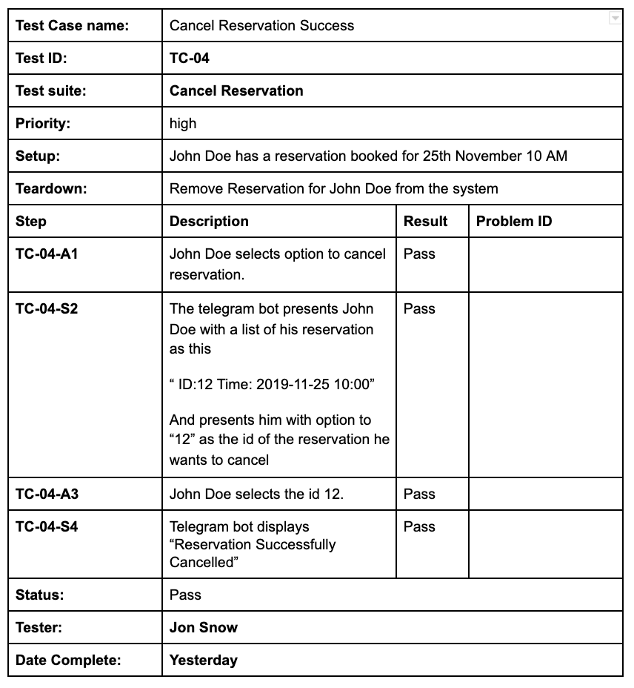
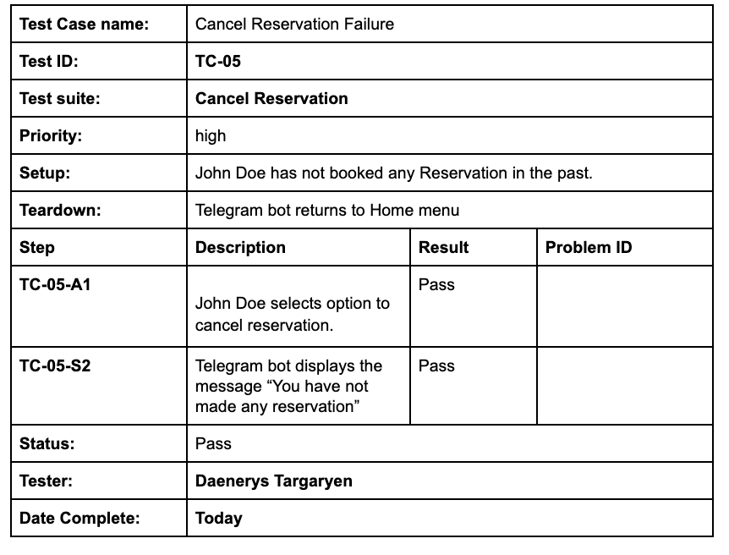
Quality management - test cases
Notes:
From the test cases we go to the test case matrices

Slide 11
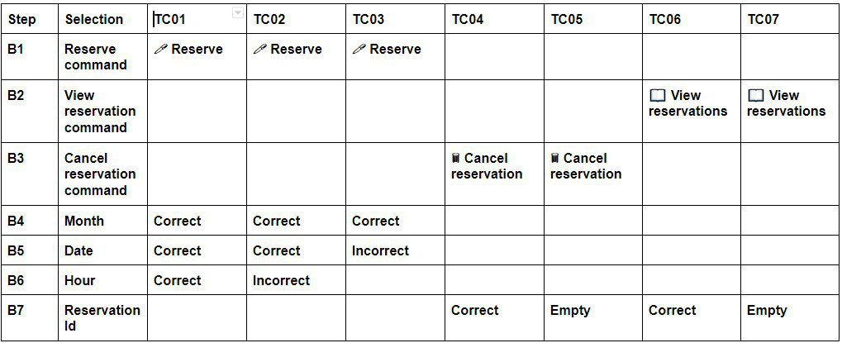
Quality management - test matrices
Notes:
From the test cases we go to the test case matrices where we assign different options for different selections to combine test cases

Slide 12
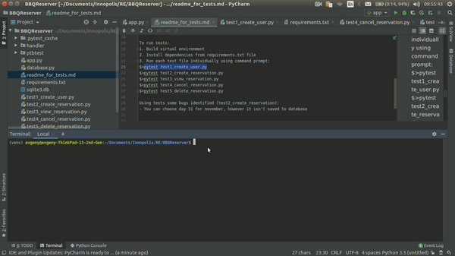
Quality assurance - test run demo

Slide 13
Teamwork & communication
We need some expertise in the domain knowledge from the previous team
We clarified the use cases when we had doubts about them
We asked about testing techniques for telegram bots

Slide 14
Lessons learned
Life is unfair
Use cases change over time.
Finishing other team’s project is hard: technology, codebase, standards. We changed the codebase 90%
Use cases are important: tool for communication, used in MVP development and test cases
Look at 1st Lesson

Slide 15
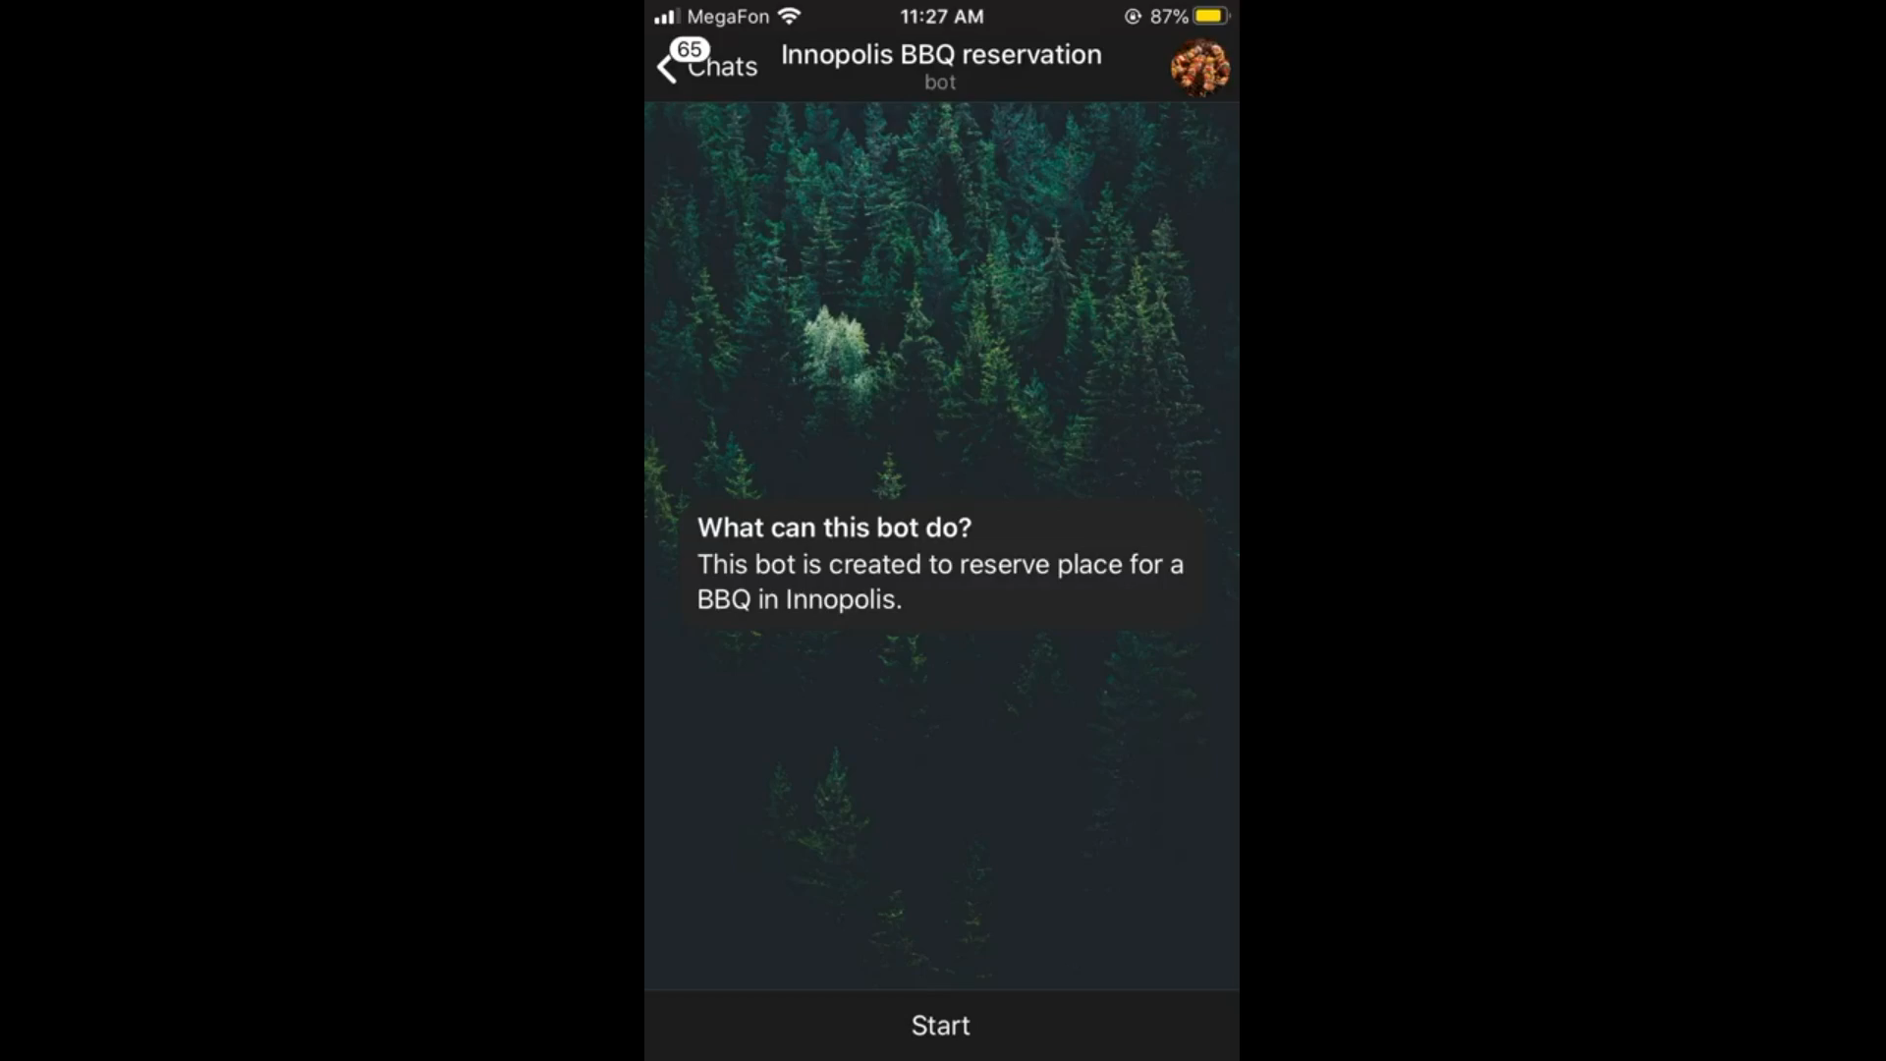
Software Demo

Slide 16
Implementation strengths & weaknesses
Limited user input in telegram bot (no wrong command)
Full functionality from use cases is covered
Deployed to hosting and available 24/7
Dates in past are available for reservation
Restrictions for testing telegram bots
One minor bug with time slots was identified

Slide 17
Thank you for attention!

